Slide 1
Group 1 - Why Do Statistics + How to Prepare Data for Analytics
By: Bhisma Adhikari, Jacob Hubbard, and Noah Dunn

Slide 2
Statistic vs Parameter
Statistic -How we describe a sample with numbers.
Ex: The number of Miami University’s 4Paws dogs that have brown fur based upon data from a sample of those dogs
Parameter - How we describe a population with numbers.
Ex: The number of males that are left-handed based on data from every male in existence (the total population).

Slide 3
Single Variable Statistics
We may want to know the results of measuring a single type of variable.
Ex: Either of the two previous examples, or
The count of red-headed men in the CSE department

Slide 4
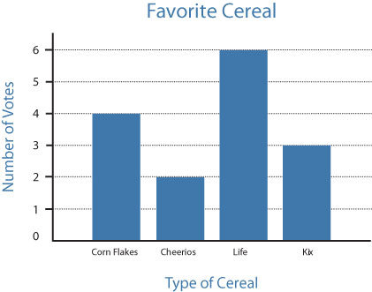
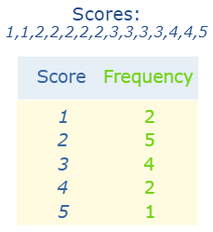
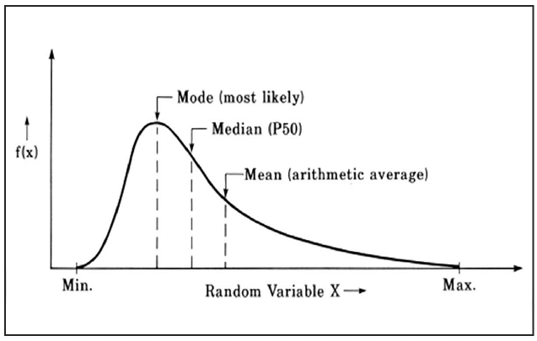
Techniques for Showing Single Variable Statistics
Source: https://www.researchgate.net/figure/Measures-of-central-tendency-Robinson_fig7_38108766
Source: http://www.ldonline.org/article/43814/
Source: https://www.mathsisfun.com/data/frequency-distribution.html

Slide 5
Multi-Variable Statistics
Describe association among/between variables. These are still just descriptive statistics, but they describe association in some way.
Ex: At time t1, a person’s metabolism was at 60% usage and their caloric intake was 1200 Calories.

Slide 6
Descriptive Statistics
Purpose: Describe the distribution and relationship among variables
No inference is made
Includes both single and multi-variable statistics

Slide 7
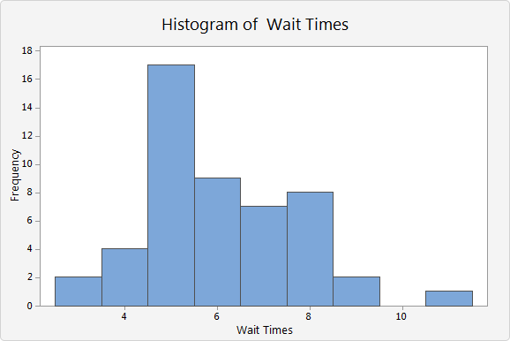
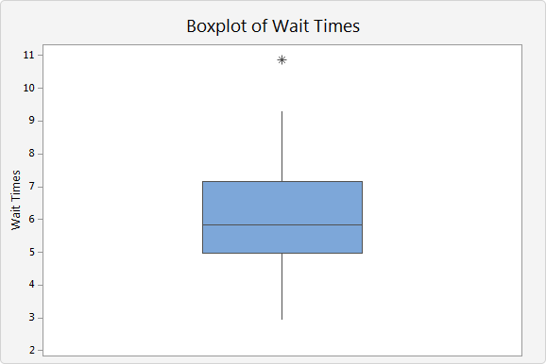
Descriptive Statistics
Frequency distributions
Graphs
Measures of Central tendency
and variation, and reliability tests
Cross-tabulation

Slide 8
Inferential Statistics
Purpose: To estimate the degree of confidence that can be placed in generalizations from a sample to the population from which the sample was selected.

Slide 9

Inferential Statistics
Example: Generalize diameters of all nails
Measure diameters of a representative sample of nails
Take average (generalize)

Slide 10
How to Prepare Data for Analysis

Slide 11
Obtaining Data for Analysis
Conducting your own survey or experiment
Quantitative data must be prepared in a format suitable for computer entry
Questionnaires and other data entry forms can be designed this way.
Each question can be a variable
Secondary data
Collected by someone other than the researcher or the researcher’s assistants.

Slide 12
Preparing Data for Analysis
Data cleaning
Data must be entered into a database
Data must be carefully checked for errors (“cleaning the data”)
Defining the data
Computer program must be written that will do the following:
Identifies variables coded in each column
Attach meaningful labels to the codes (so we know “PARTYID3” means “Politics”)
Distinguishes values that represent missing data

Slide 13
The End

